Slide 1
Multi-species Catalogues of Regulatory Elements: Ensembl
Session 3
T6: Making the most of cis-regulatory annotations for genome-scale analysis
Louisse Paola Mirabueno - Garth Ilsley
Ensembl Outreach Officer,
Ensembl Outreach,
EMBL-EBI
Project Lead
Ensembl Regulation,
EMBL-EBI
03/09/2026

Slide 2
Hands-on

Slide 3
Ensembl Regulation
Answer the following questions:
Explore the indicated locus on the Genome View tab:
GRCh38, chr8:127,682,026-127,744,101
GRCm39/mm39, chr6:6,740,753-6,891,103
Display and explore regulatory features using the Regulation card.
Filter epigenomes based on the given criteria:
GRCh38: Caco-2 and HCT116 cell lines
GRCm39: Forebrain epigenomes
Compare regulatory activity across the group of selected epigenemes.
Inspect supporting epigenomic evidence in the indicated epigenome.
Identify at least one context-dependent example.
Compare the results with the ones obtained in the previous session.

Slide 4
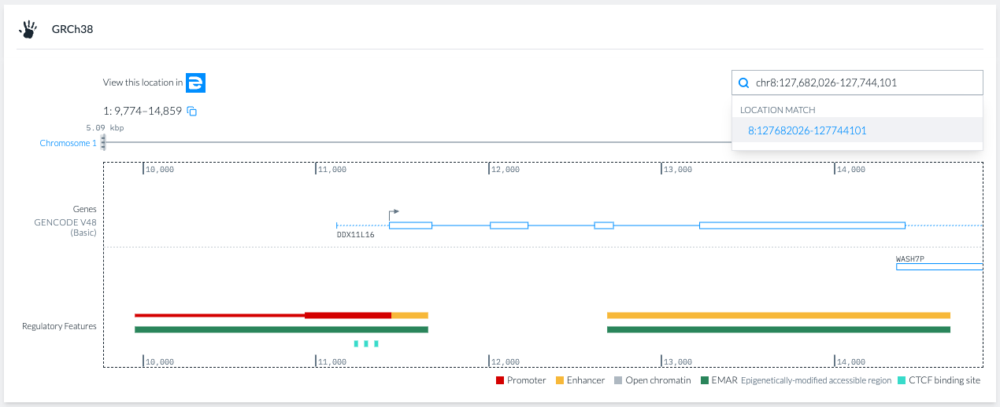
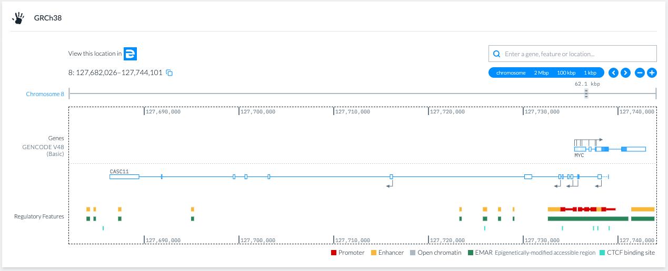
Ensembl Regulation: GRCh38
Explore the indicated locus on the Genome View tab:

Slide 5
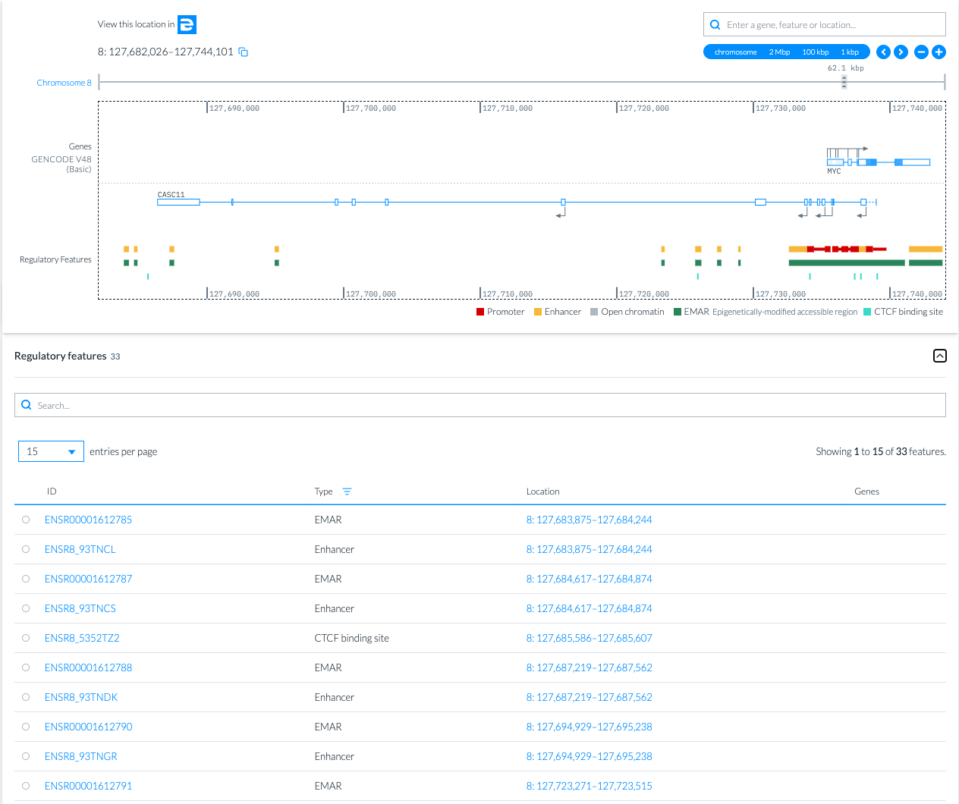
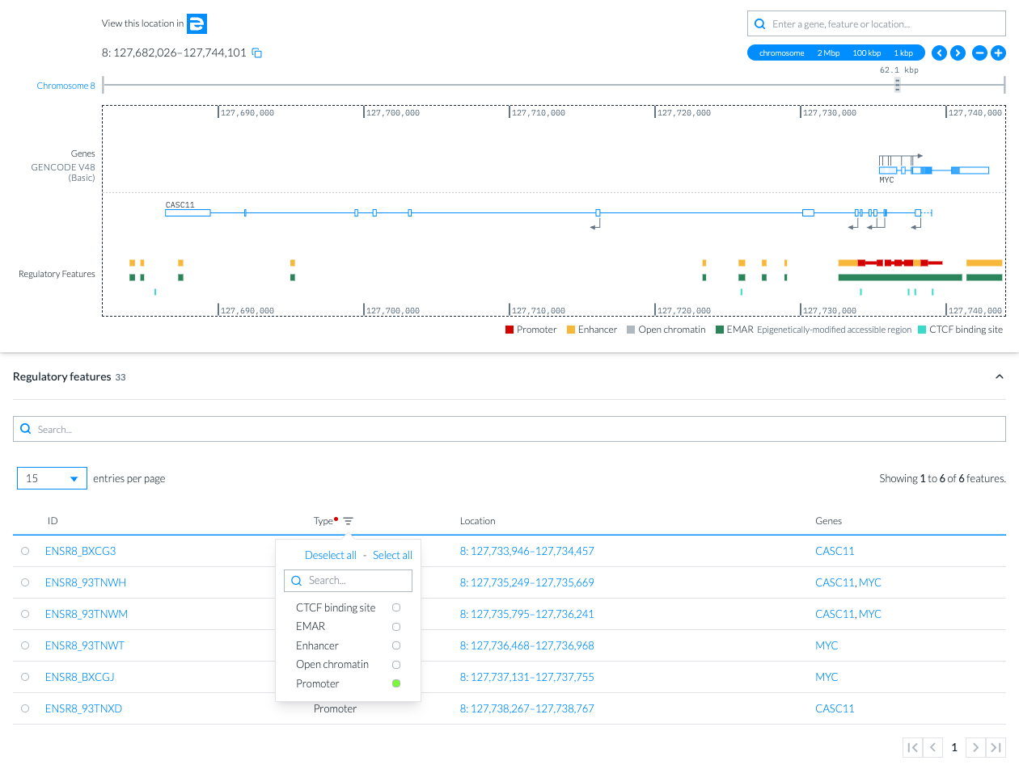
Ensembl Regulation: GRCh38
Display and explore regulatory features using the Regulation card.

Slide 6
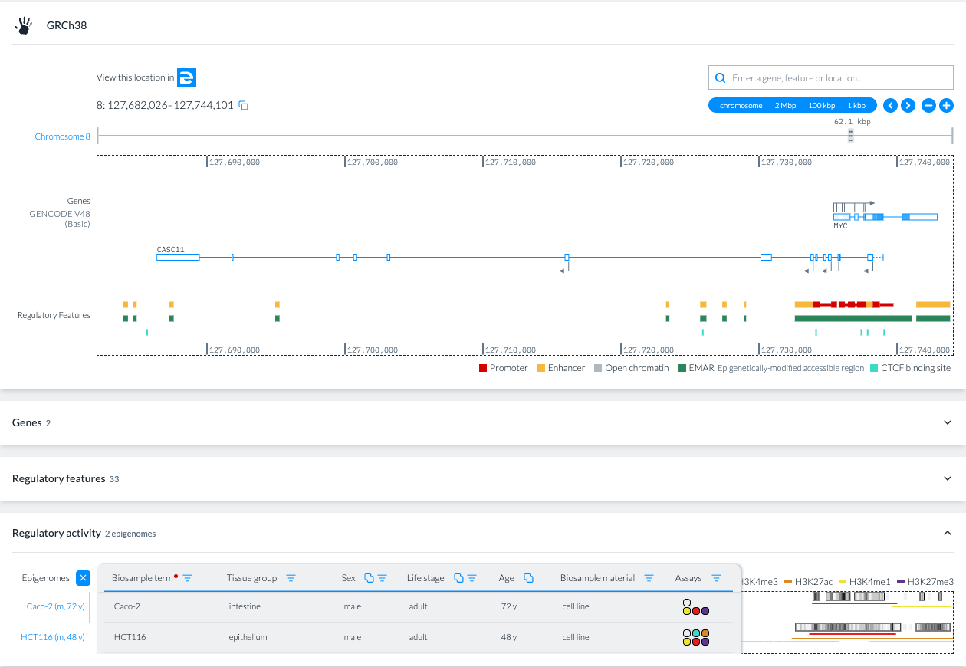
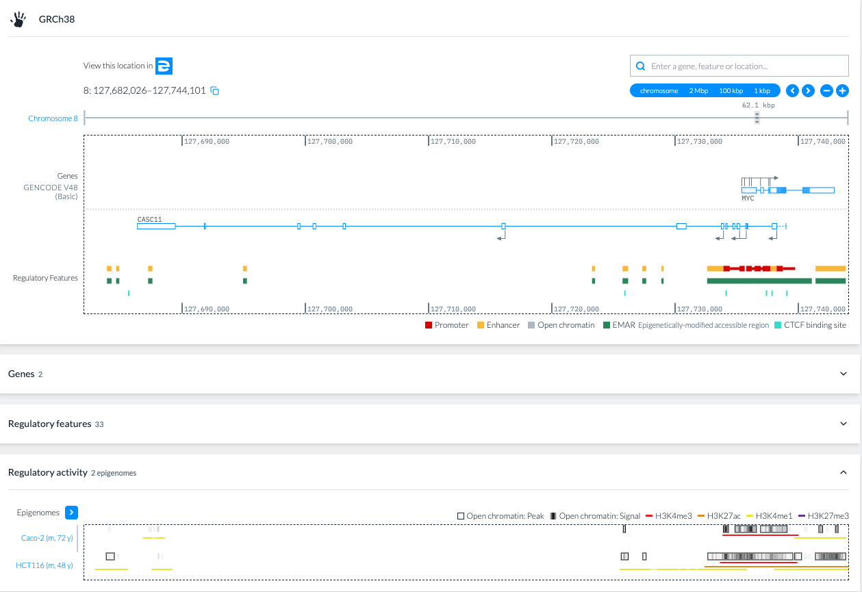
Ensembl Regulation: GRCh38
Filter epigenomes based on the given criteria: GRCh38: Caco-2 and HCT116 cell lines

Slide 7
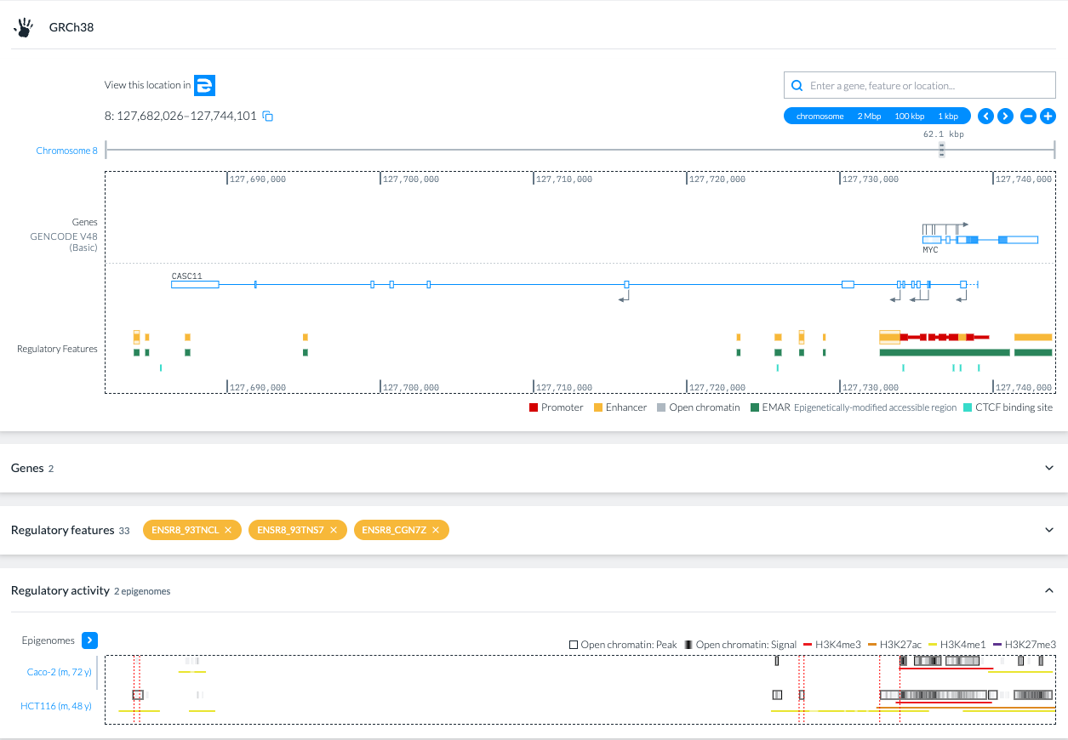
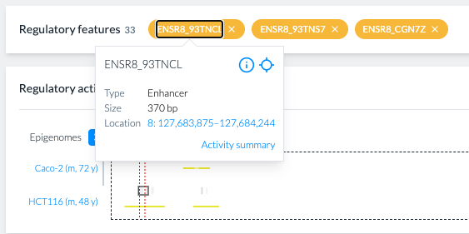
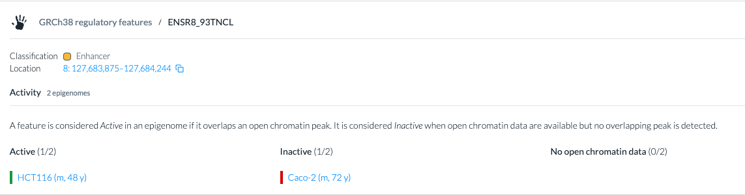
Ensembl Regulation: GRCh38
Compare regulatory activity across the group of selected epigenemes

Slide 8
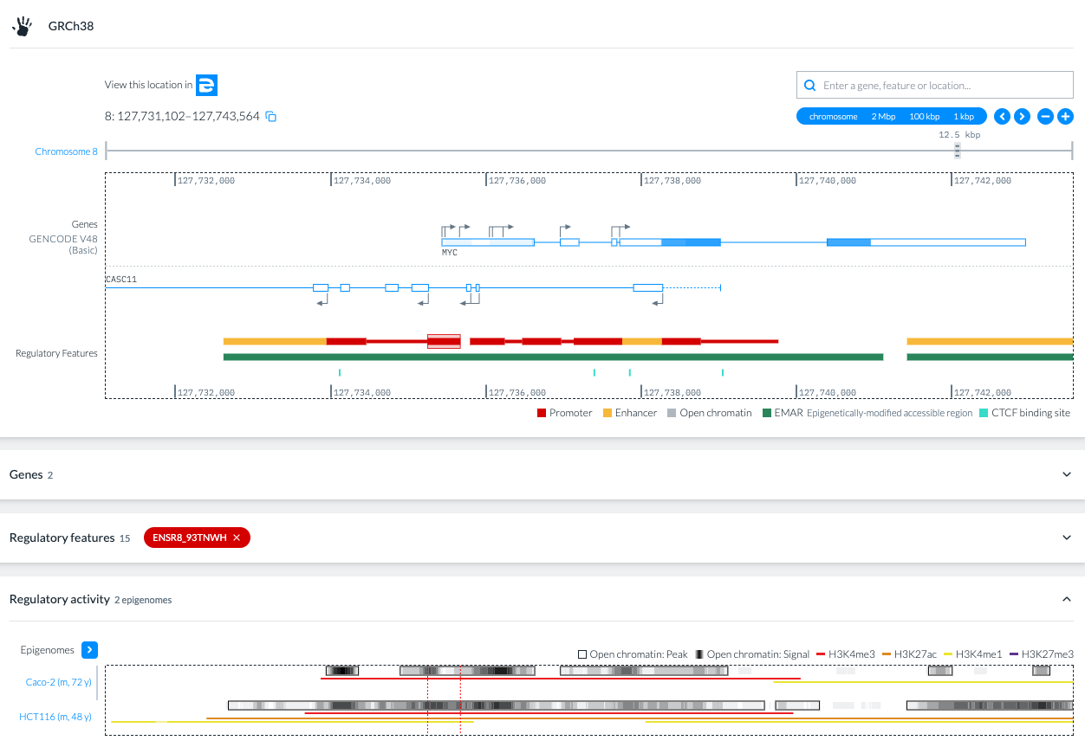
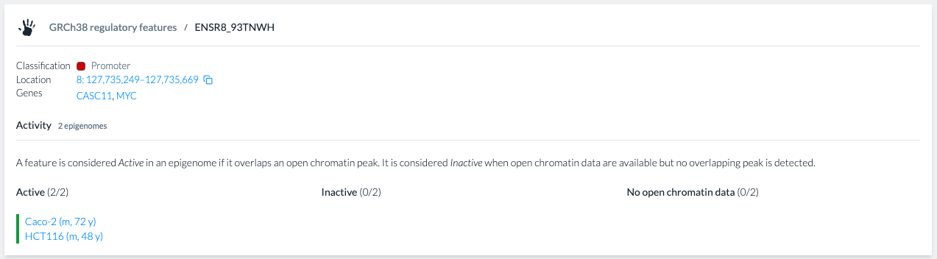
Ensembl Regulation: GRCh38
Compare regulatory activity across the group of selected epigenemes

Slide 9
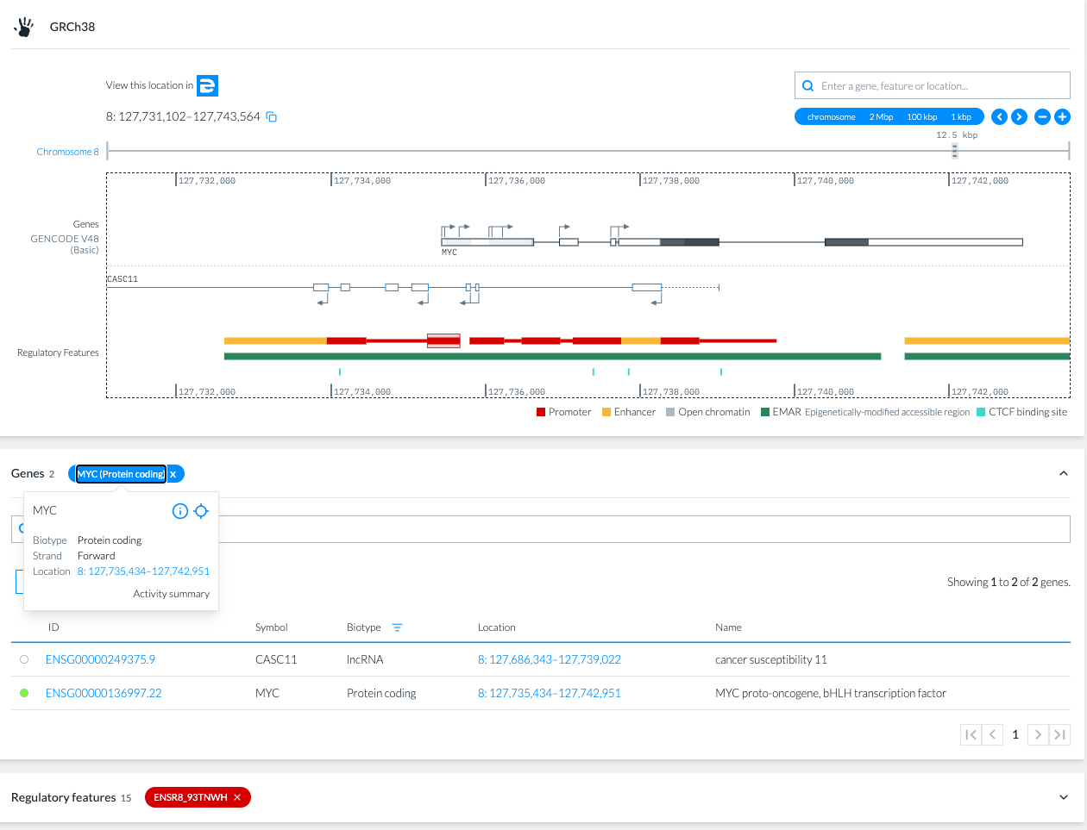
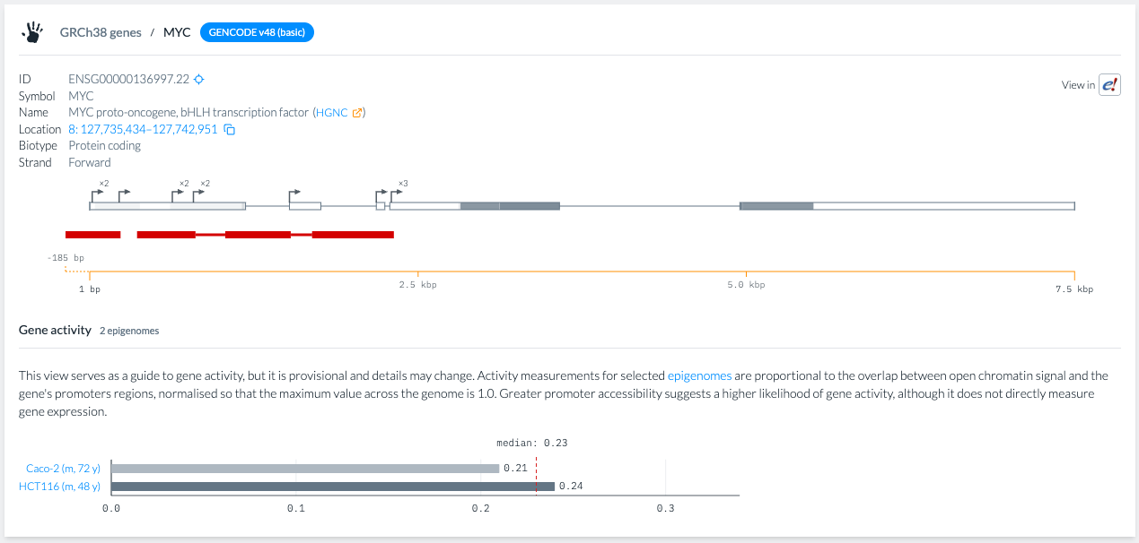
Ensembl Regulation: GRCh38
Compare regulatory activity across the group of selected epigenemes

Slide 10
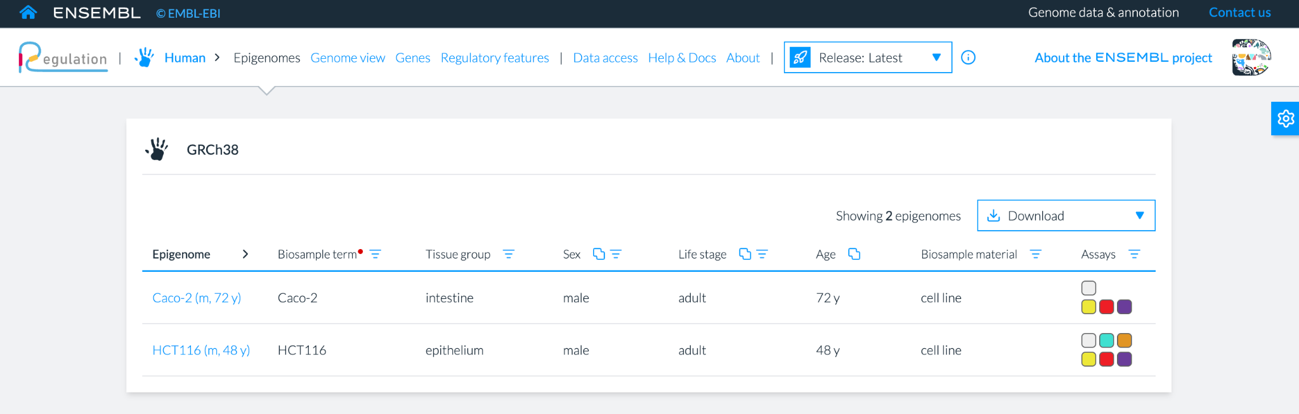
Ensembl Regulation: GRCh38
Inspect supporting epigenomic evidence in the indicated epigenome

Slide 11
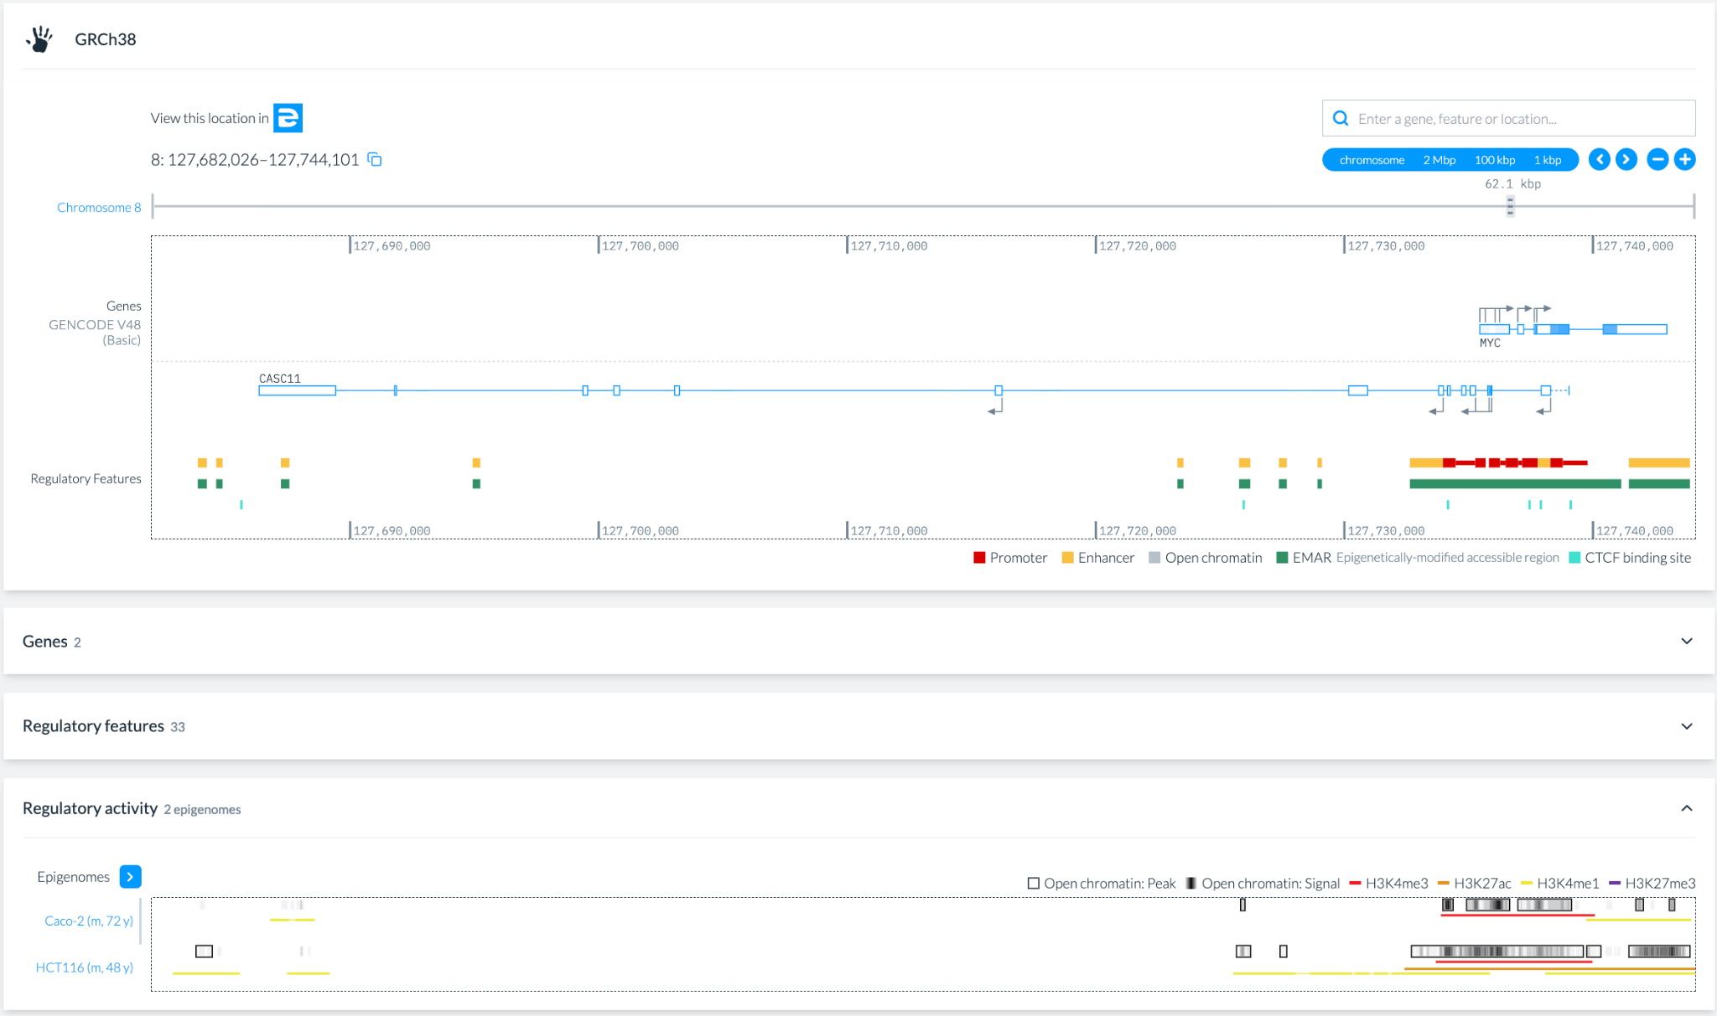
Ensembl Regulation: GRCh38
Inspect supporting epigenomic evidence in the indicated epigenome

Slide 12
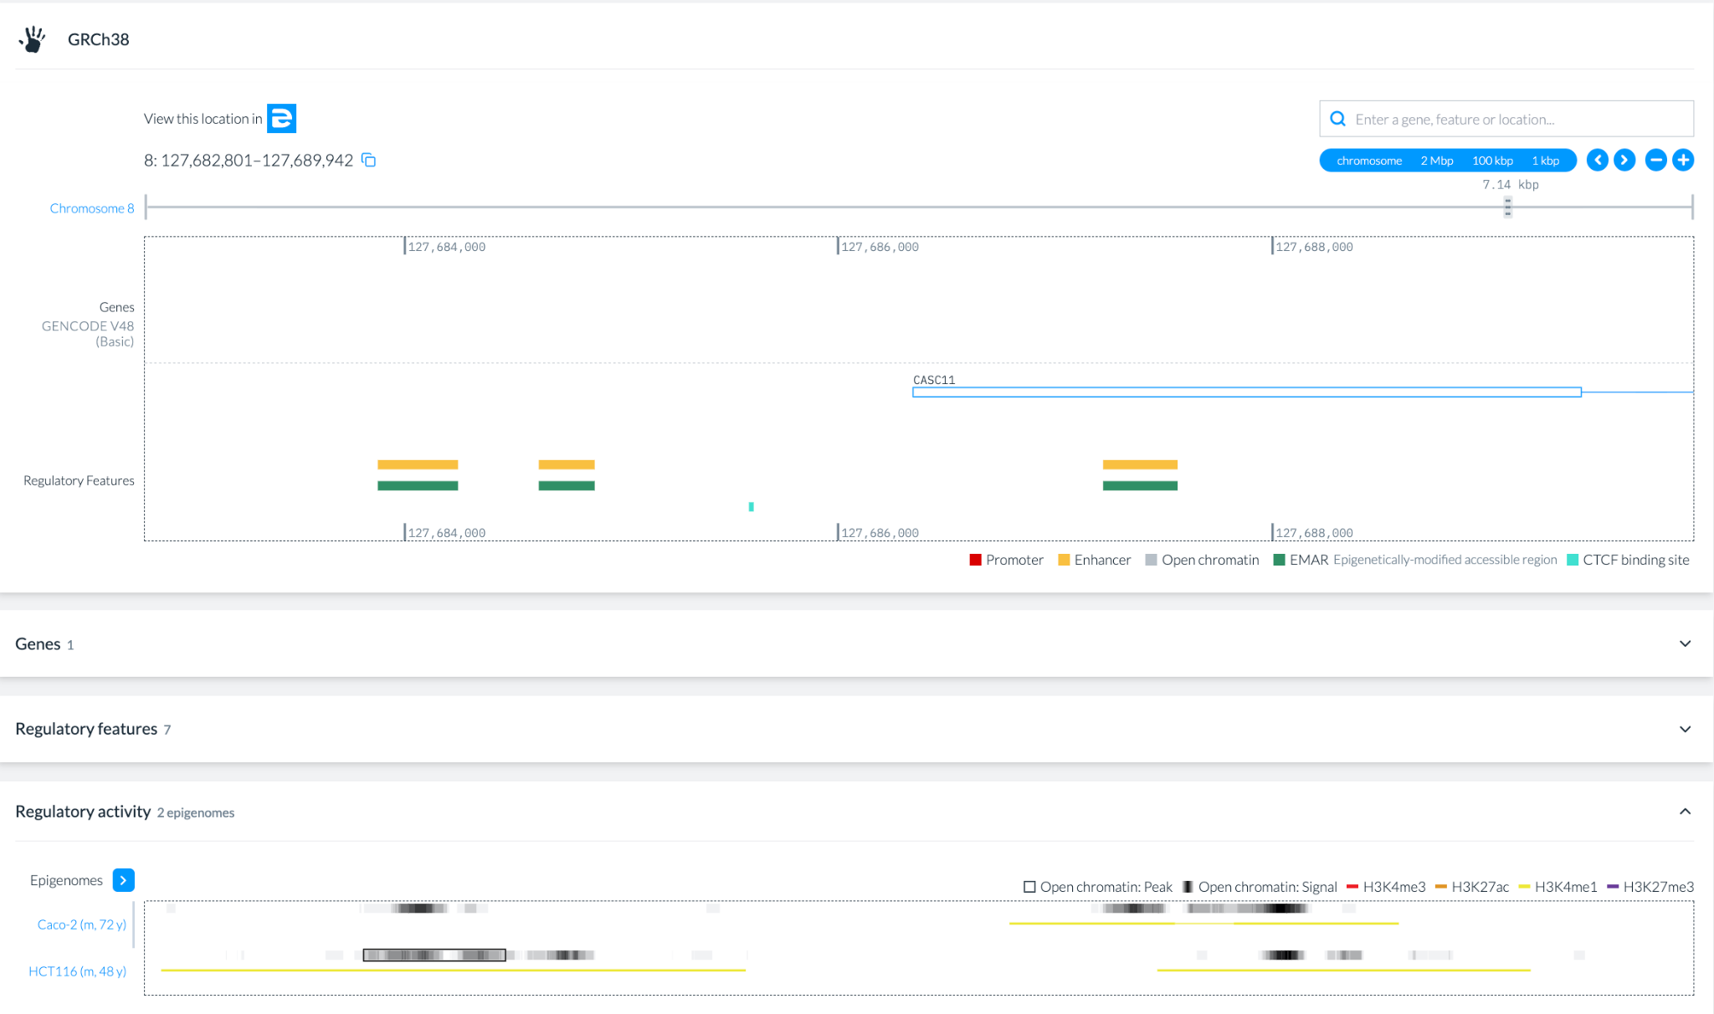
Ensembl Regulation: GRCh38
Inspect supporting epigenomic evidence in the indicated epigenome

Slide 13
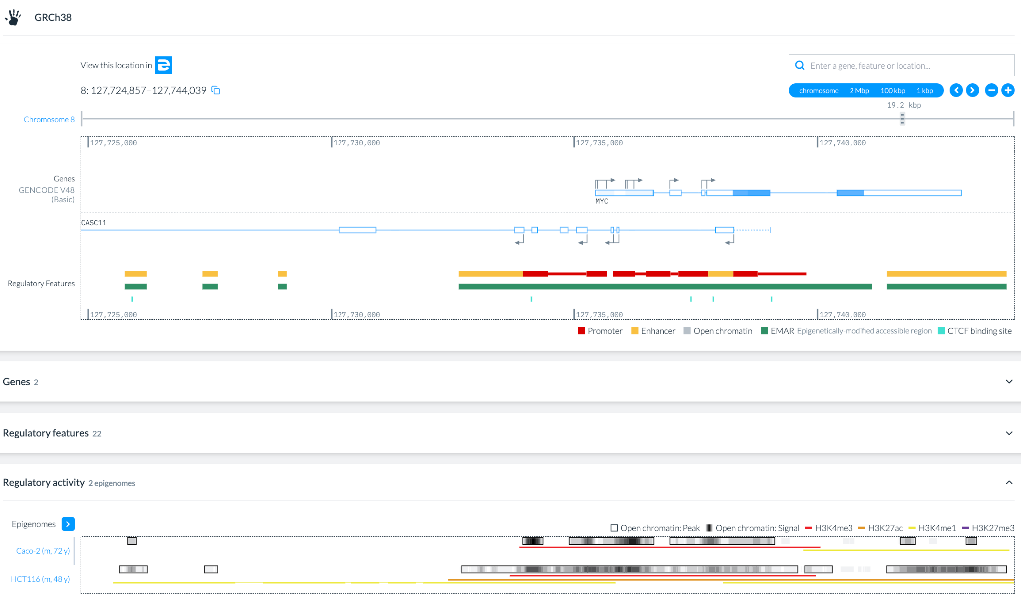
Ensembl Regulation: GRCh38
Inspect supporting epigenomic evidence in the indicated epigenome

Slide 14
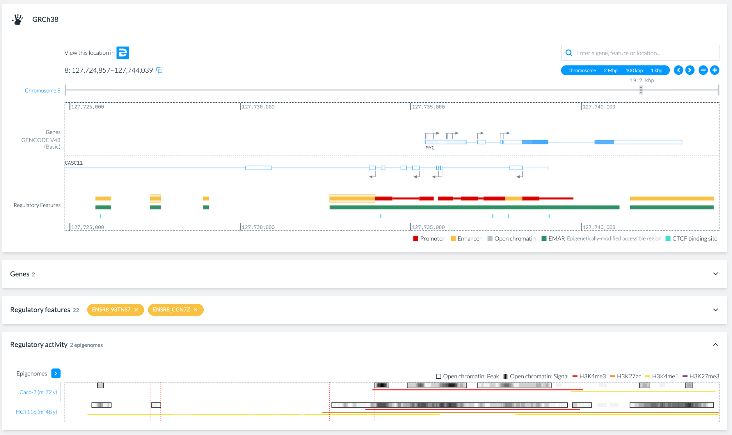
Ensembl Regulation: GRCh38
Identify at least one context-dependent example.
The ENSR8_93TNS7 and ENSR8_CGN7Z enhancers are only active in HCT116

Slide 15
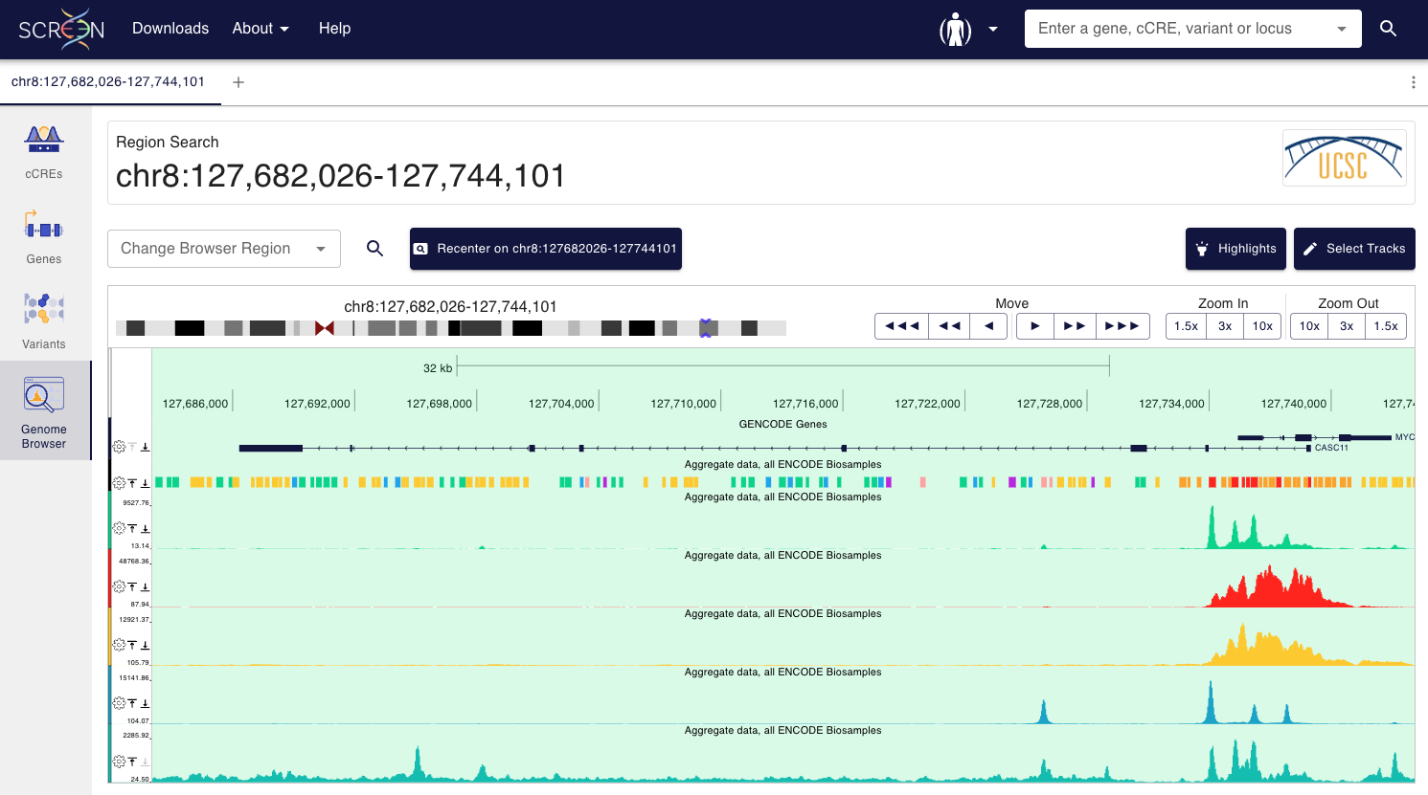
Ensembl Regulation: GRCh38
Compare the results with the ones obtained in the previous session.

Slide 16
Ensembl Regulation
Answer the following questions:
Explore the indicated locus on the Genome View tab:
GRCh38, chr8:127,682,026-127,744,101
GRCm39/mm39, chr6:6,740,753-6,891,103
Display and explore regulatory features using the Regulation card.
Filter epigenomes based on the given criteria:
GRCh38: Caco-2 and HCT116 cell lines
GRCm39: Forebrain epigenomes
Compare regulatory activity across the group of selected epigenemes.
Inspect supporting epigenomic evidence in the indicated epigenome.
Identify at least one context-dependent example.
Compare the results with the ones obtained in the previous session.

Slide 17
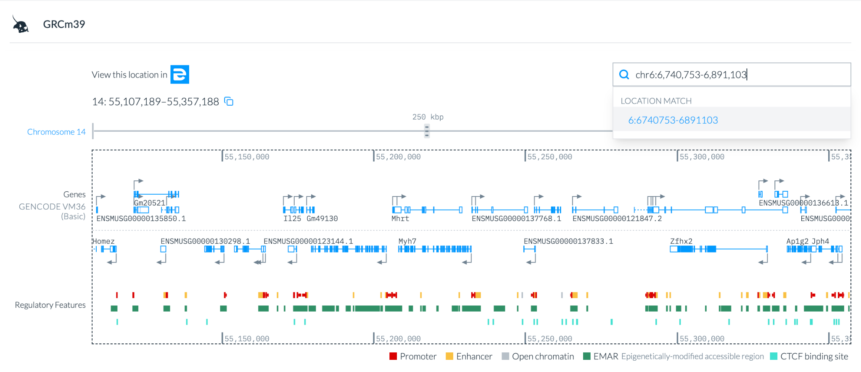
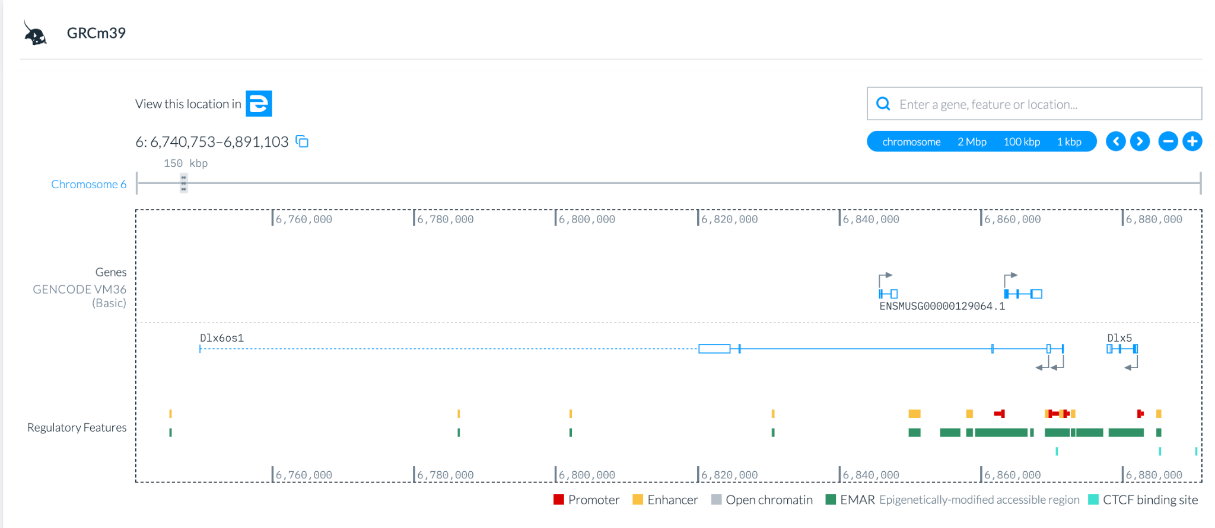
Ensembl Regulation: GRCm39
Explore the indicated locus on the Genome View tab:

Slide 18
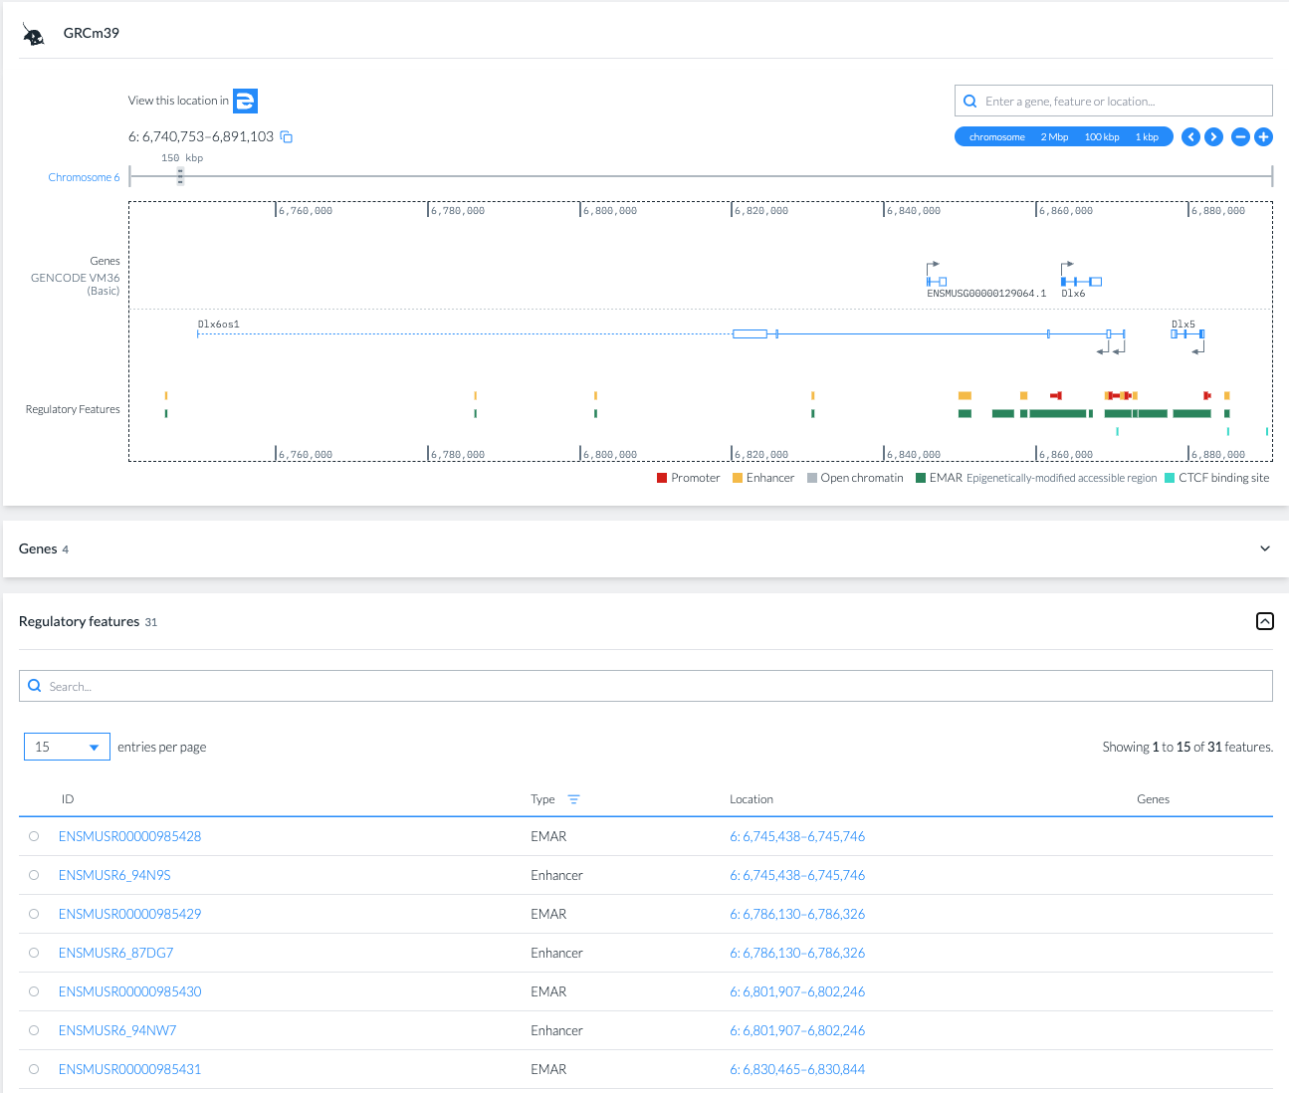
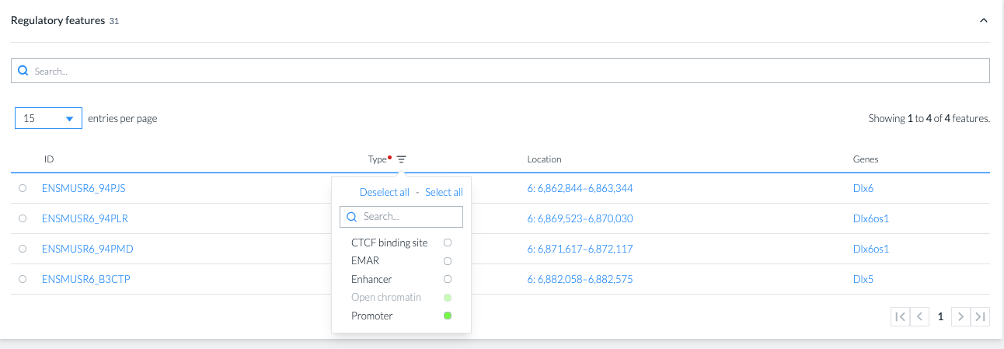
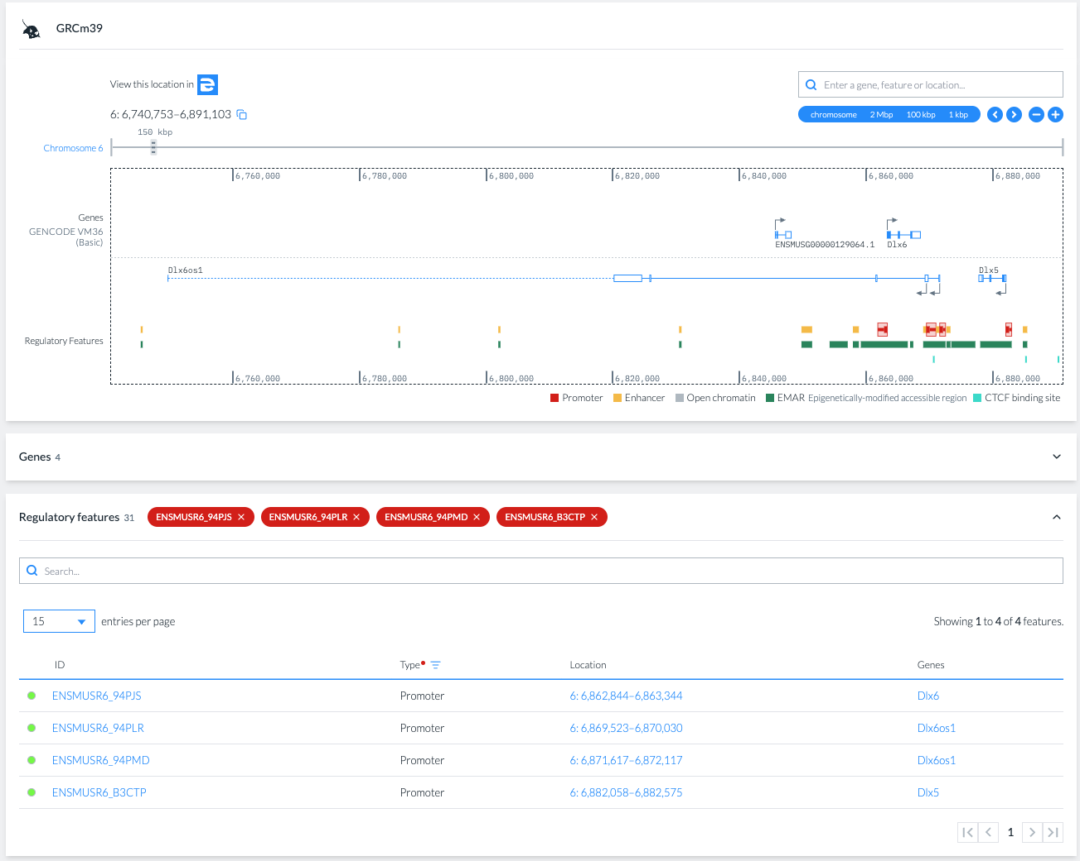
Ensembl Regulation: GRCm39
Display and explore regulatory features using the Regulation card.

Slide 19
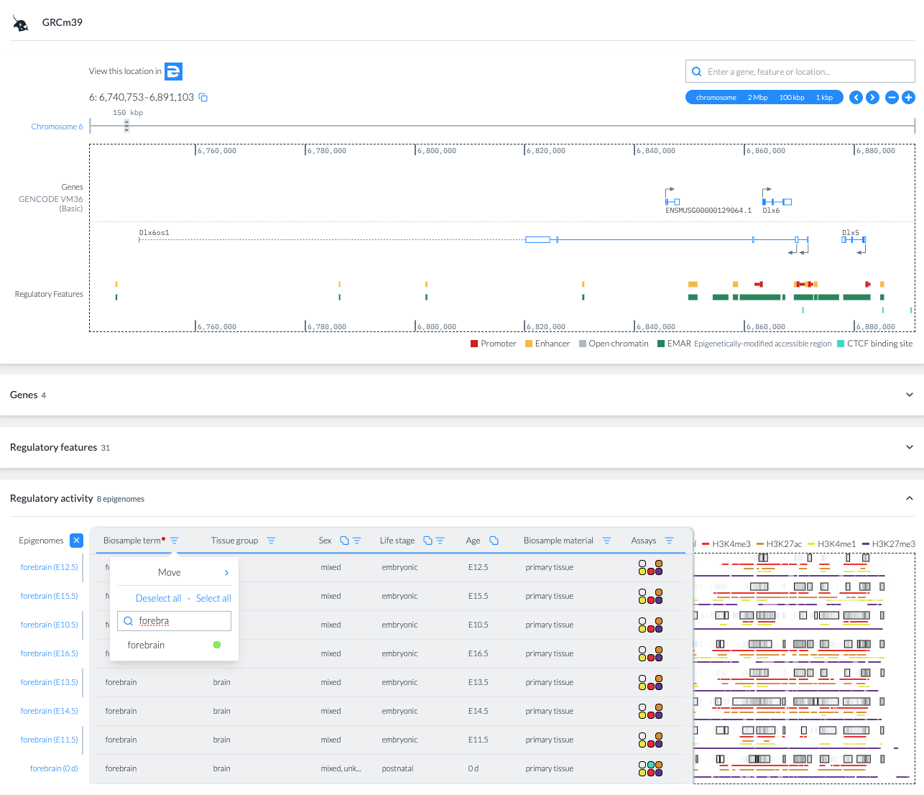
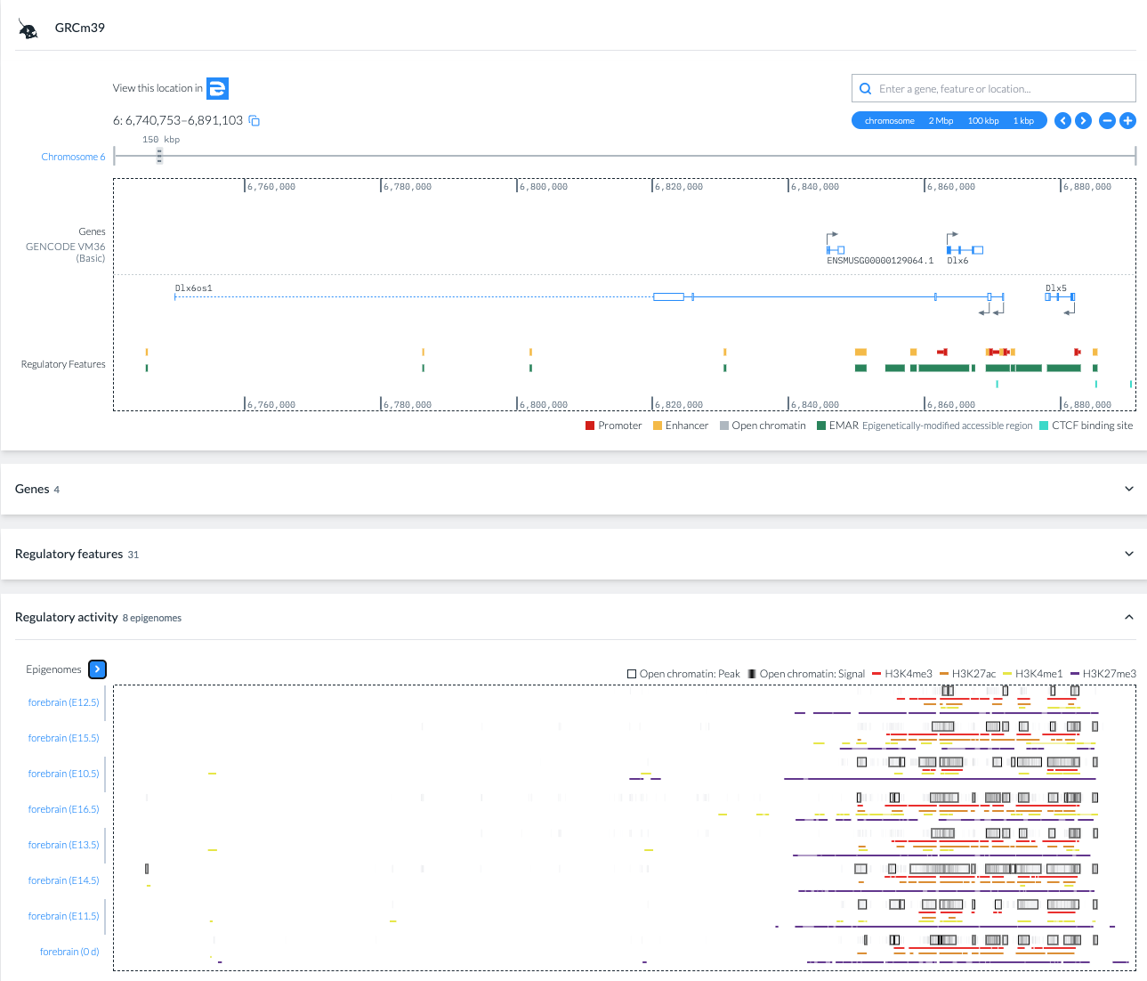
Ensembl Regulation: GRCm39
Filter epigenomes based on the given criteria: GRCm39: Forebrain epigenomes

Slide 20
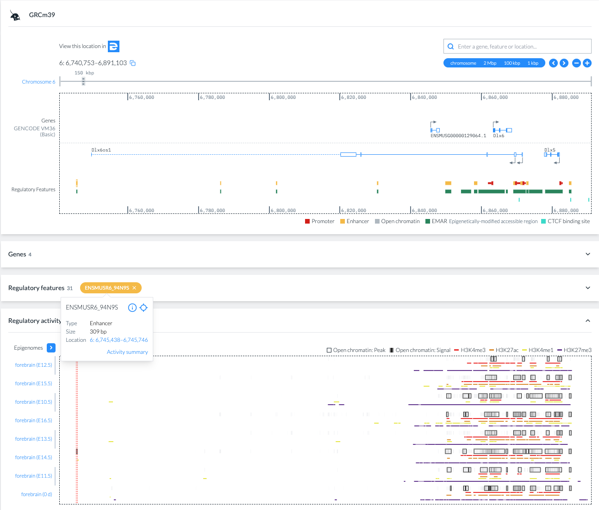
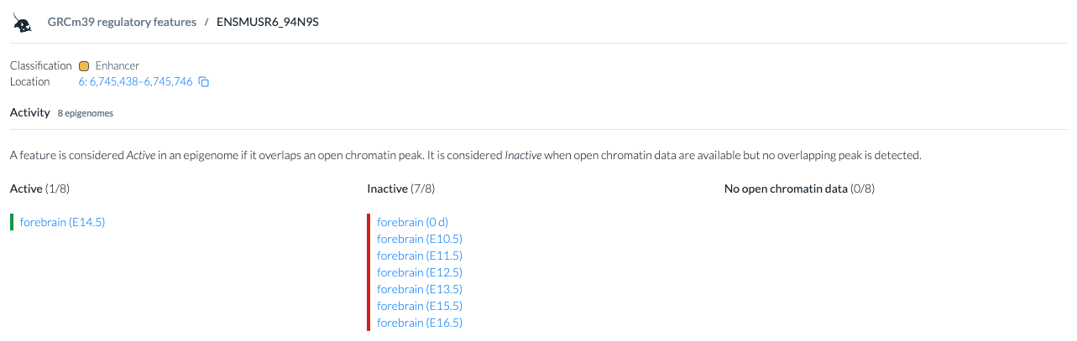
Ensembl Regulation: GRCm39
Compare regulatory activity across the group of selected epigenemes

Slide 21
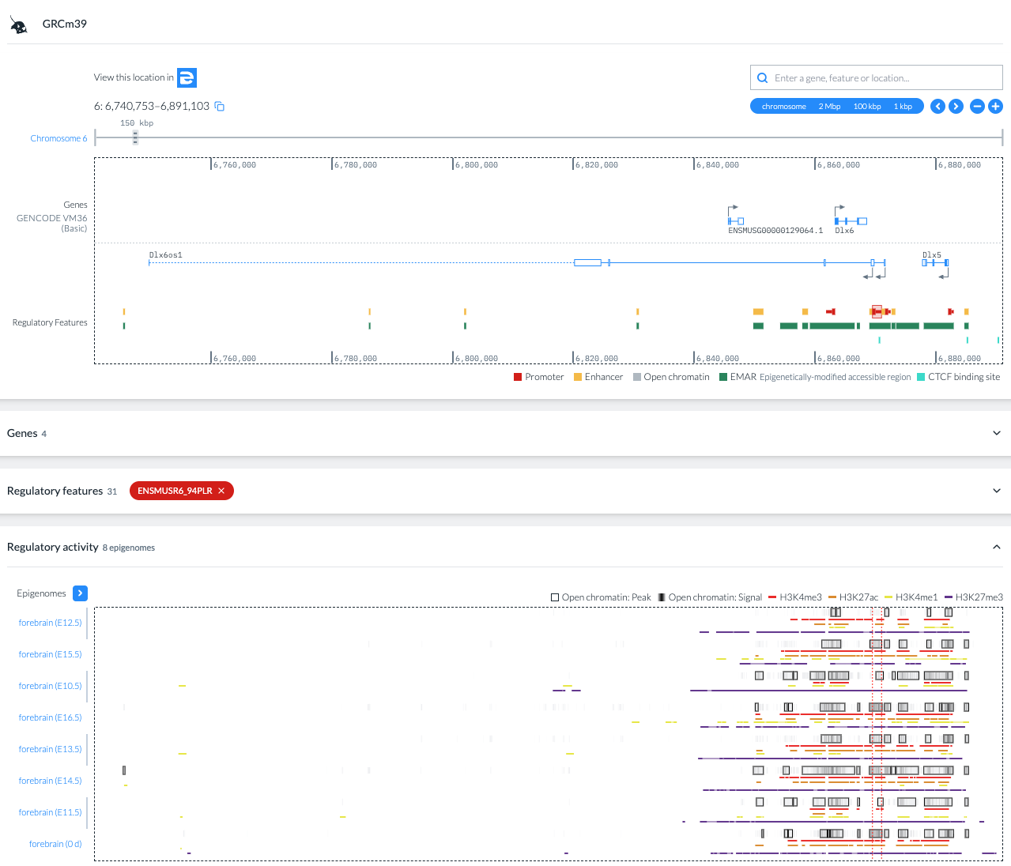
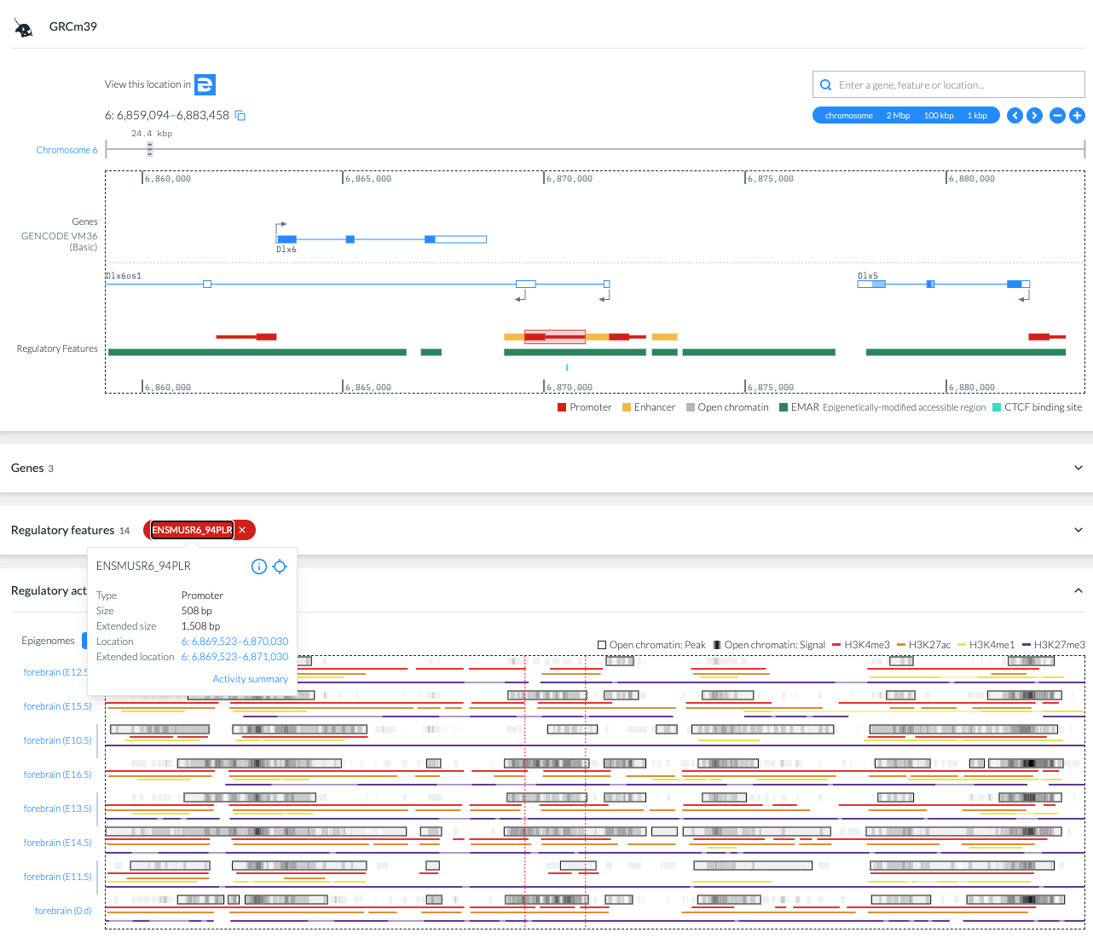
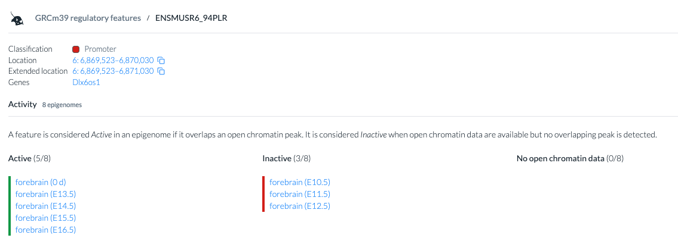
Ensembl Regulation: GRCm39
Compare regulatory activity across the group of selected epigenemes

Slide 22
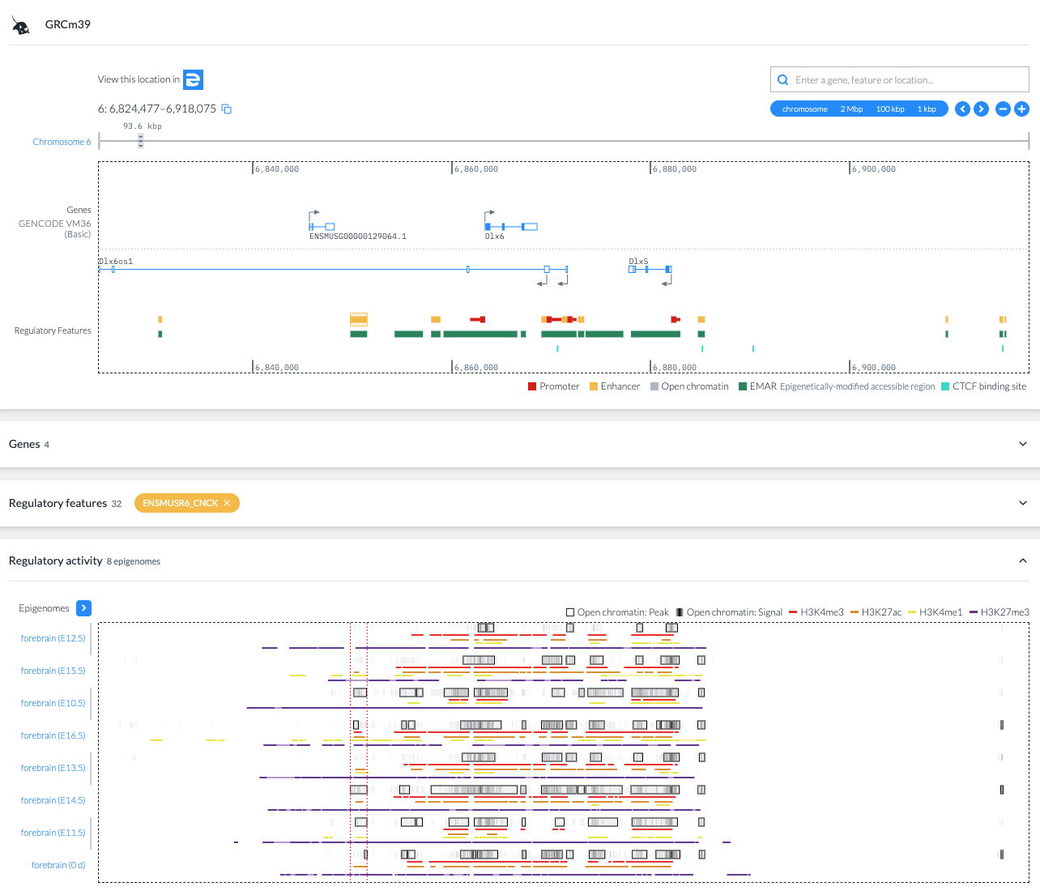
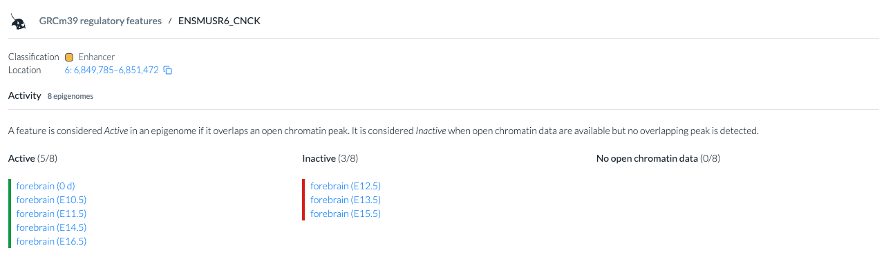
Ensembl Regulation: GRCm39
Compare regulatory activity across the group of selected epigenemes

Slide 23
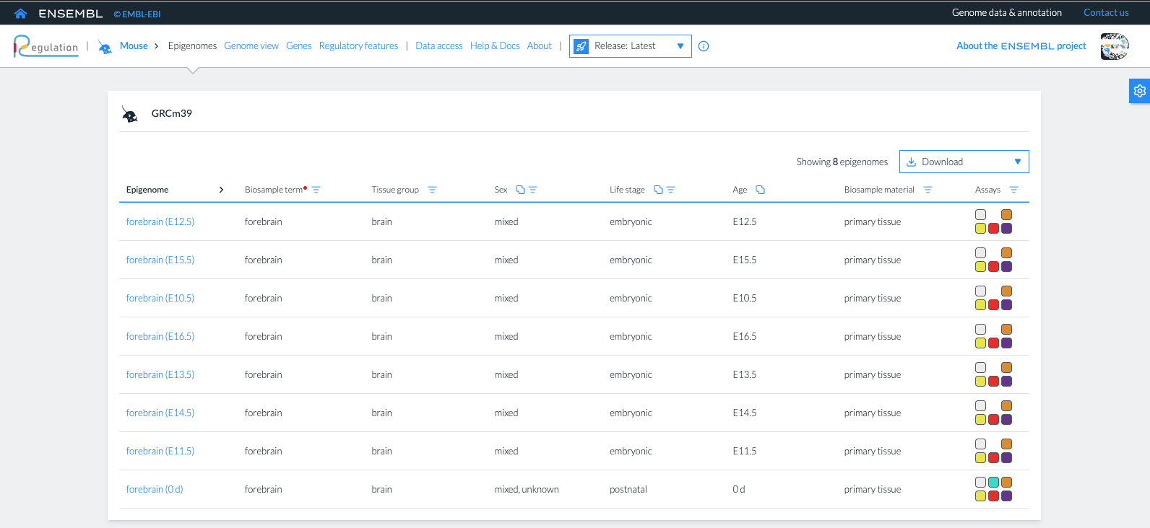
Ensembl Regulation: GRCm39
Inspect supporting epigenomic evidence in the indicated epigenome

Slide 24
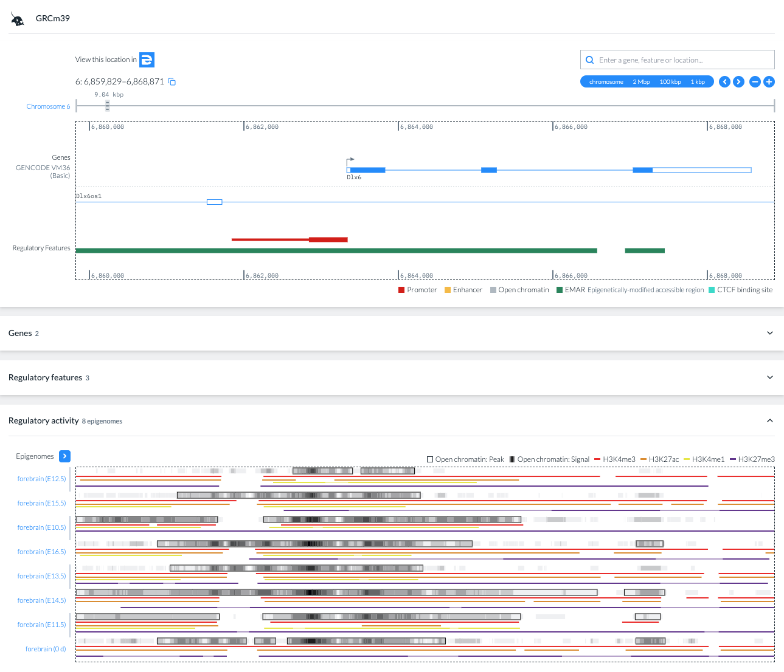
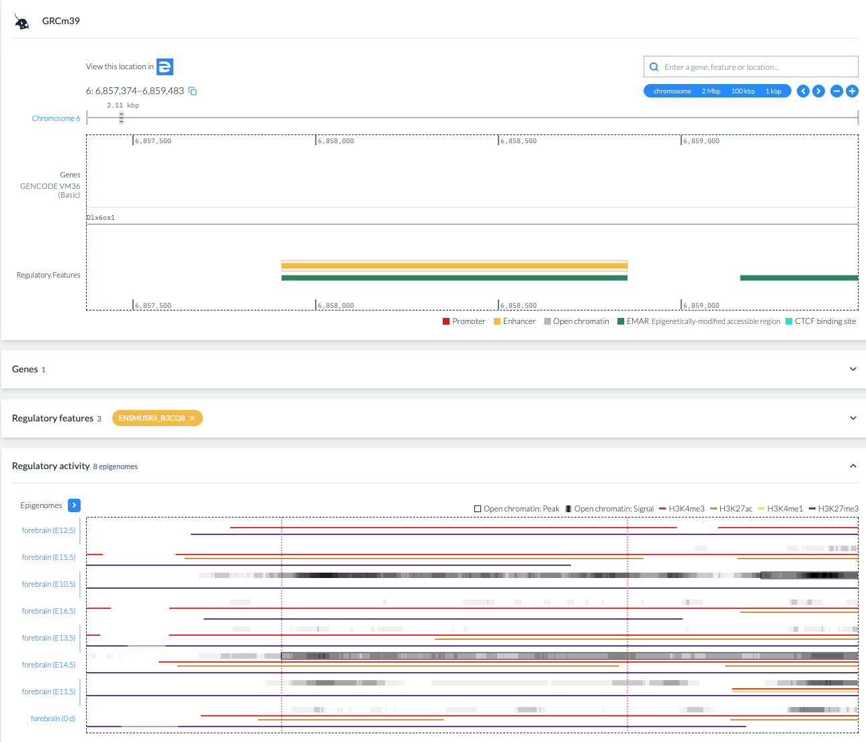
Ensembl Regulation: GRCm39
Inspect supporting epigenomic evidence in the indicated epigenome

Slide 25
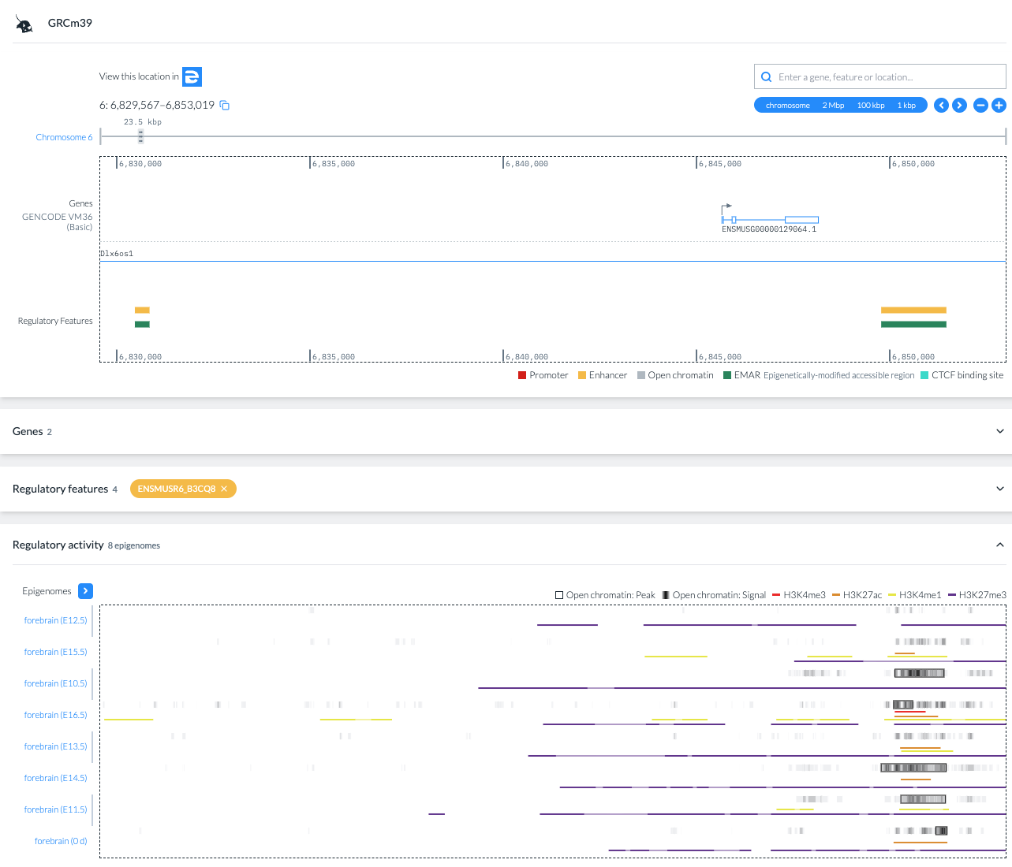
Ensembl Regulation: GRCm39
Inspect supporting epigenomic evidence in the indicated epigenome

Slide 26
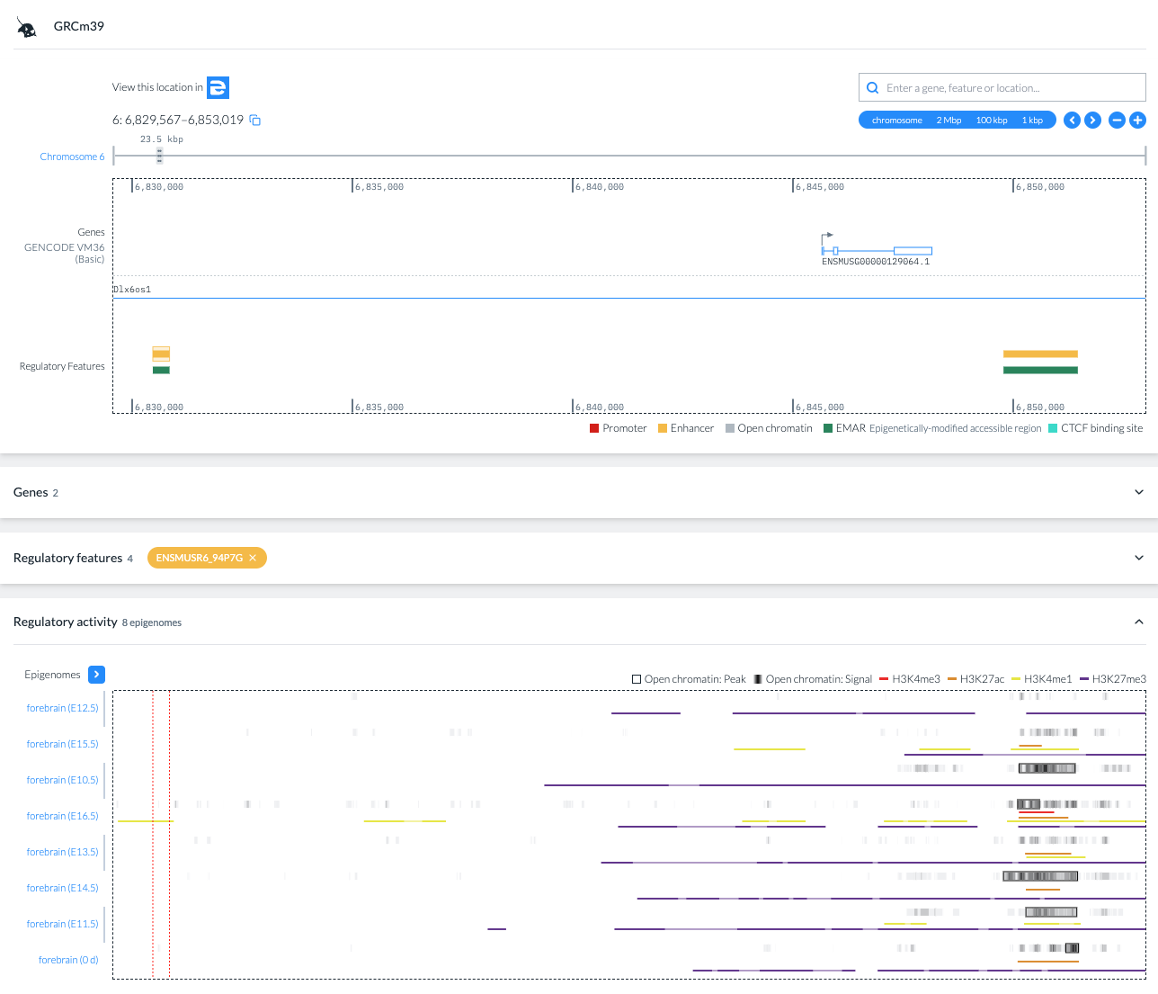
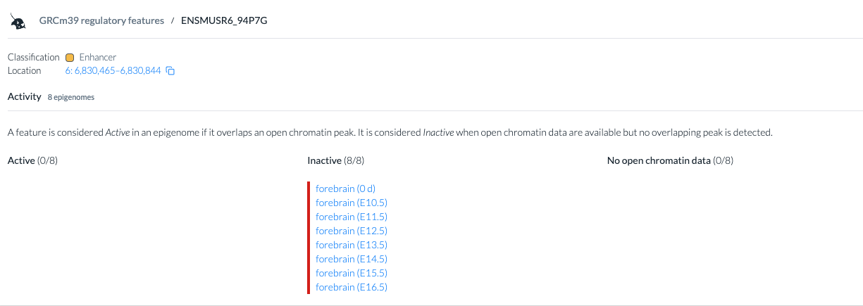
Ensembl Regulation: GRCm39
Identify at least one context-dependent example.
The ENSMUSR6_94P7G enhancer is inactive in all forebrain epigenomes

Slide 27
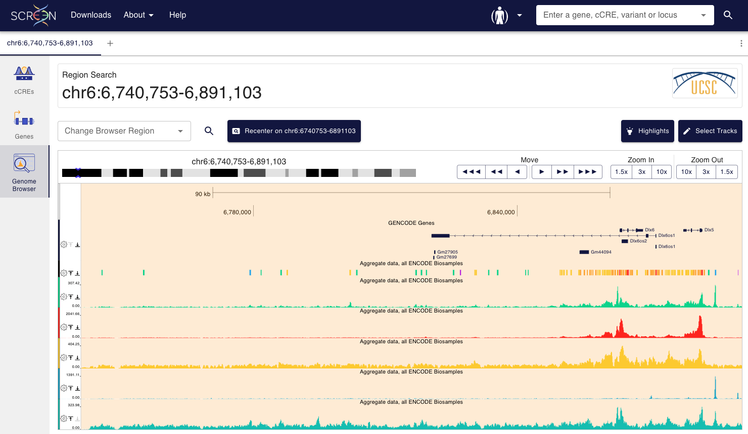
Ensembl Regulation: GRCm39
Compare the results with the ones obtained in the previous session. Note that in this case the comparison is possible because the coordinates are the same in mm10 and GRCm39

